Slide 1
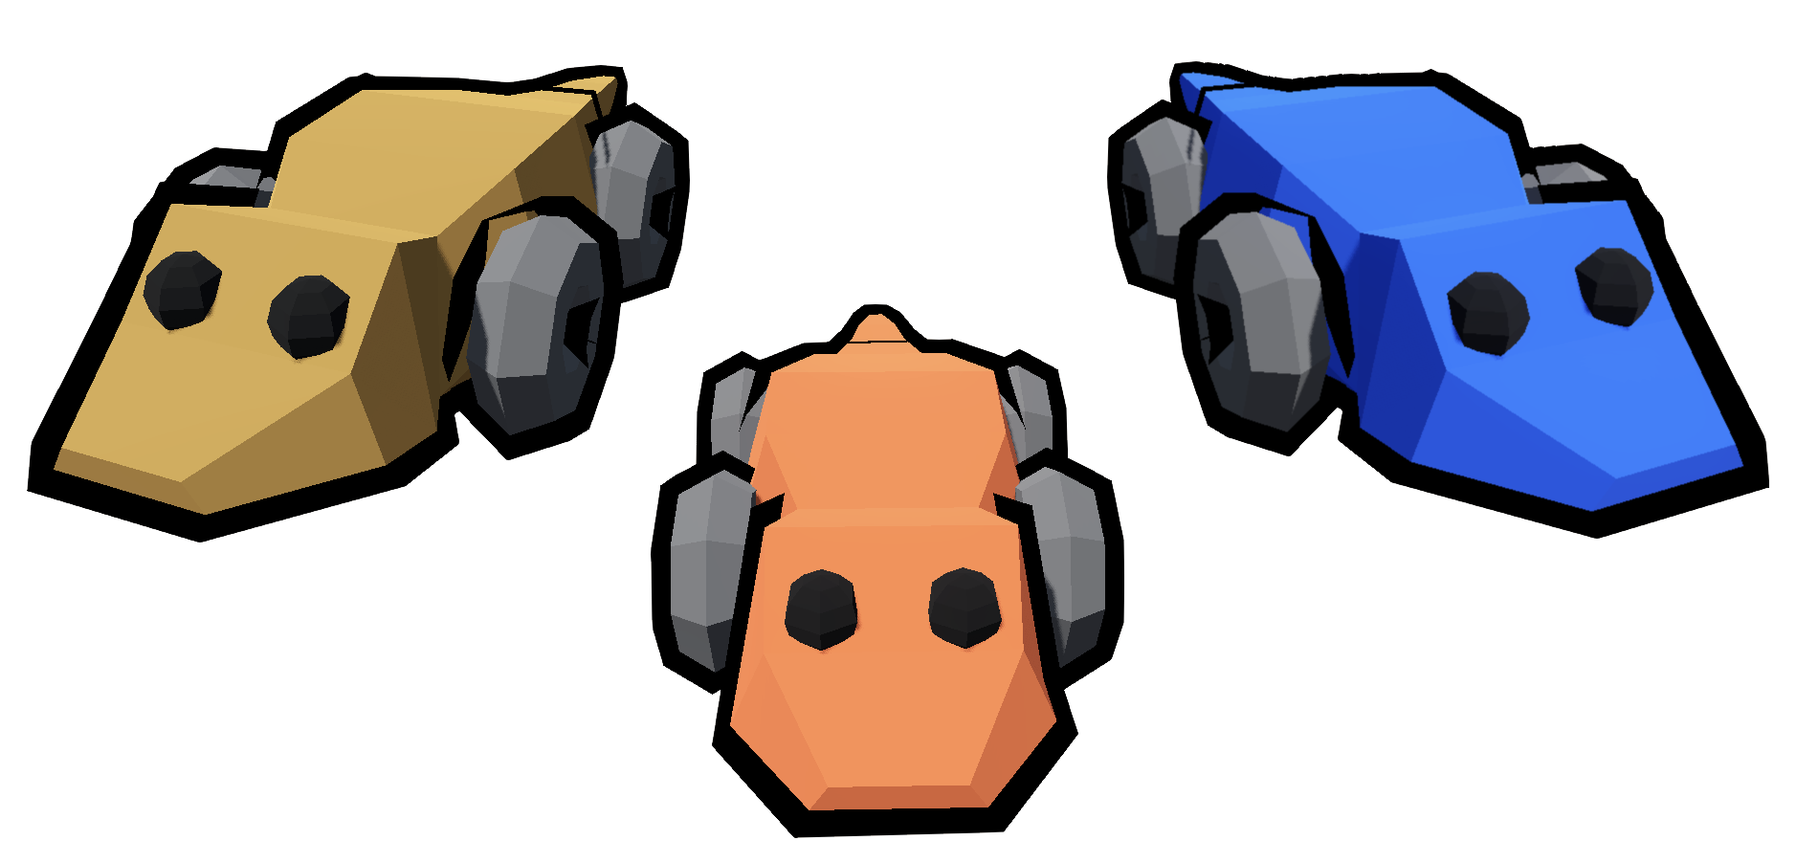
Uta Stansburiana Sillycon Desert
a Uta Stansburiana Rock-Paper-Scissor population model
Presented by: Alessandro Scala and Salvatore Salerno
Academic Year 2023/2024

Slide 2
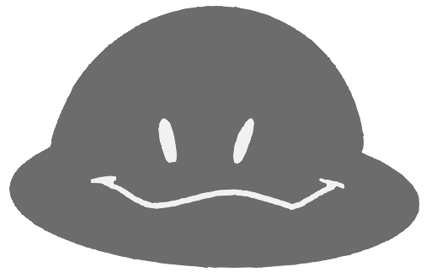
Presented by: Alessandro Scala and Salvatore Salerno
Computation Models for Complex Systems
Computation Models for Complex Systems
Outline
Introduction to the lizard species
Rock-Paper-Scissors Pattern
Using the Godot Engine
Modelling the morphs
Modelling behaviours
Conclusions

Slide 3

Introduzione al progetto
Presented by: Alessandro Scala and Salvatore Salerno
Presentata da: Salvatore Salerno
Università di Pisa
Dipartimento di Informatica
Computation Models for Complex Systems
Computation Models for Complex Systems
Outline
Introduction to the lizard species
Rock-Paper-Scissors Pattern
Using the Godot Engine
Modelling the morphs
Modelling behaviours
Conclusions

Slide 4
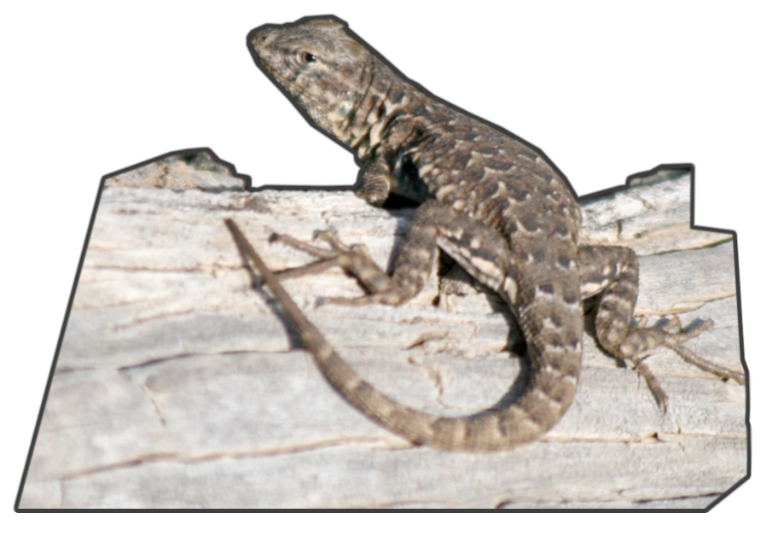
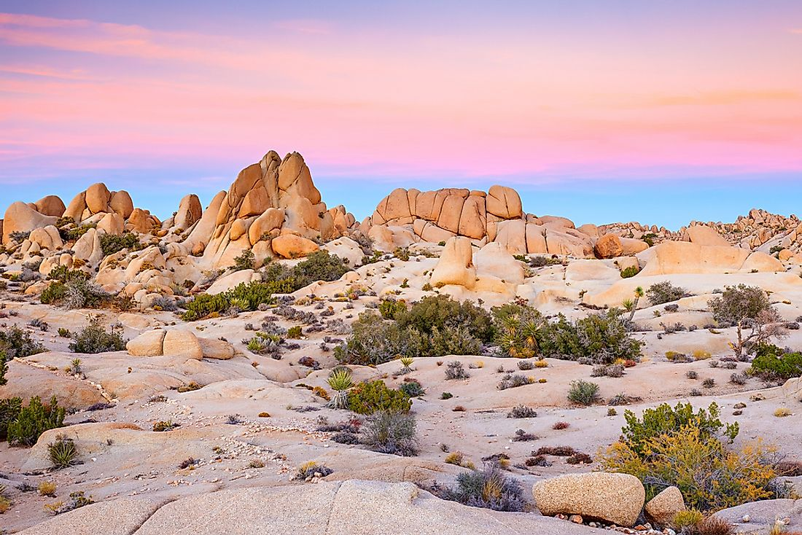
Introduzione al progetto
Presented by: Alessandro Scala and Salvatore Salerno
Presentata da: Salvatore Salerno
Università di Pisa
Dipartimento di Informatica
Computation Models for Complex Systems
Computation Models for Complex Systems
Introduction to the lizard species
“Uta stansburiana” is a species of side-blotched lizards mainly known for the peculiar behaviour of the three different male morphs in acquiring mates.
The morph is characterized by the color of their neck: Orange, Blue or Yellow
They live in deserts near the western part of the United States or in Northern Mexico.

Slide 5
Introduzione al progetto
Presented by: Alessandro Scala and Salvatore Salerno
Presentata da: Salvatore Salerno
Università di Pisa
Dipartimento di Informatica
Computation Models for Complex Systems
Computation Models for Complex Systems
Outline
Introduction to the lizard species
Rock-Paper-Scissors Pattern
Using the Godot Engine
Modelling the morphs
Modelling behaviours
Conclusions

Slide 6
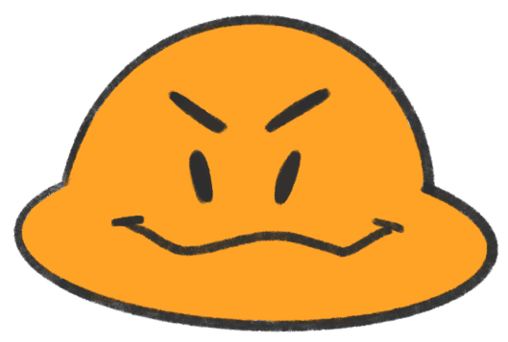
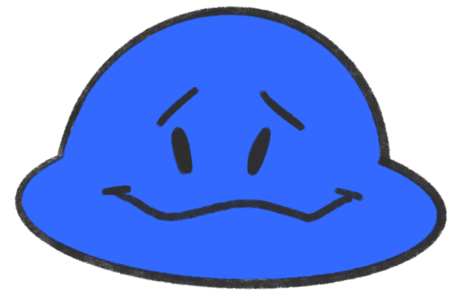

Introduzione al progetto
Presented by: Alessandro Scala and Salvatore Salerno
Presentata da: Salvatore Salerno
Università di Pisa
Dipartimento di Informatica
Computation Models for Complex Systems
Computation Models for Complex Systems
Rock-Paper-Scissors Pattern

Slide 7
Introduzione al progetto
Presented by: Alessandro Scala and Salvatore Salerno
Presentata da: Salvatore Salerno
Università di Pisa
Dipartimento di Informatica
Computation Models for Complex Systems
Computation Models for Complex Systems
Outline
Introduction to the lizard species
Rock-Paper-Scissors Pattern
Using the Godot Engine
Modelling the morphs
Modelling behaviours
Conclusions

Slide 8

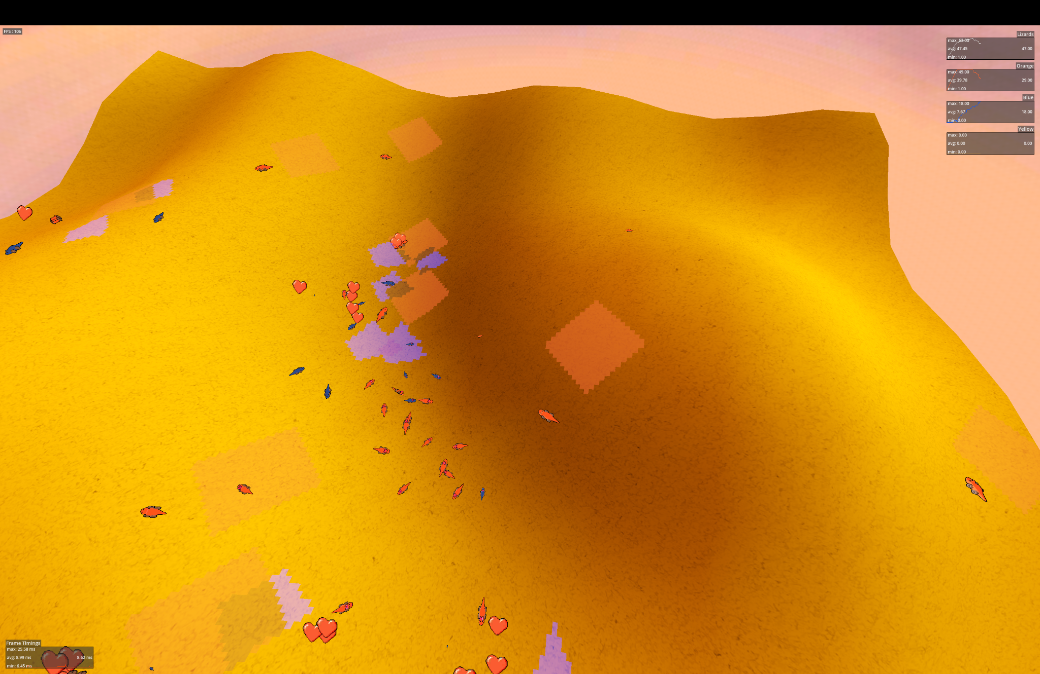
Introduzione al progetto
Presented by: Alessandro Scala and Salvatore Salerno
Presentata da: Salvatore Salerno
Università di Pisa
Dipartimento di Informatica
Computation Models for Complex Systems
Computation Models for Complex Systems
Using the Godot Engine
We decided to use the Godot Engine instead of the more common NetLogo language because:
Using a 3D engine we were able to have a better visualization of habitats, showing hills and slopes.
The customizability of GDScript allowed us to better model the complex behaviour of the various morph and interactions between them.
We were able to code more realistics and precise physics for our lizards.
The desert is procedurally generated in each run.

Slide 9
Introduzione al progetto
Presented by: Alessandro Scala and Salvatore Salerno
Presentata da: Salvatore Salerno
Università di Pisa
Dipartimento di Informatica
Computation Models for Complex Systems
Computation Models for Complex Systems
Outline
Introduction to the lizard species
Rock-Paper-Scissors Pattern
Using the Godot Engine
Modeling the morphs
Modeling behaviours
Conclusions

Slide 10
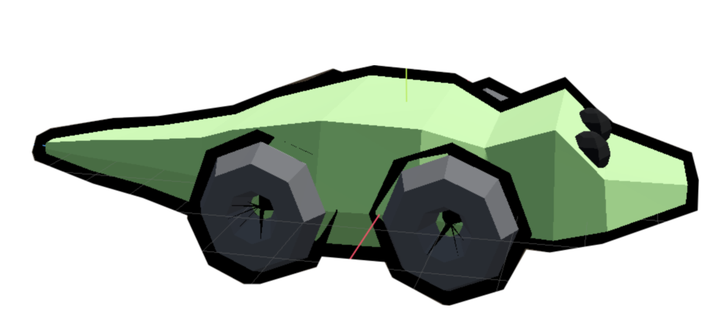
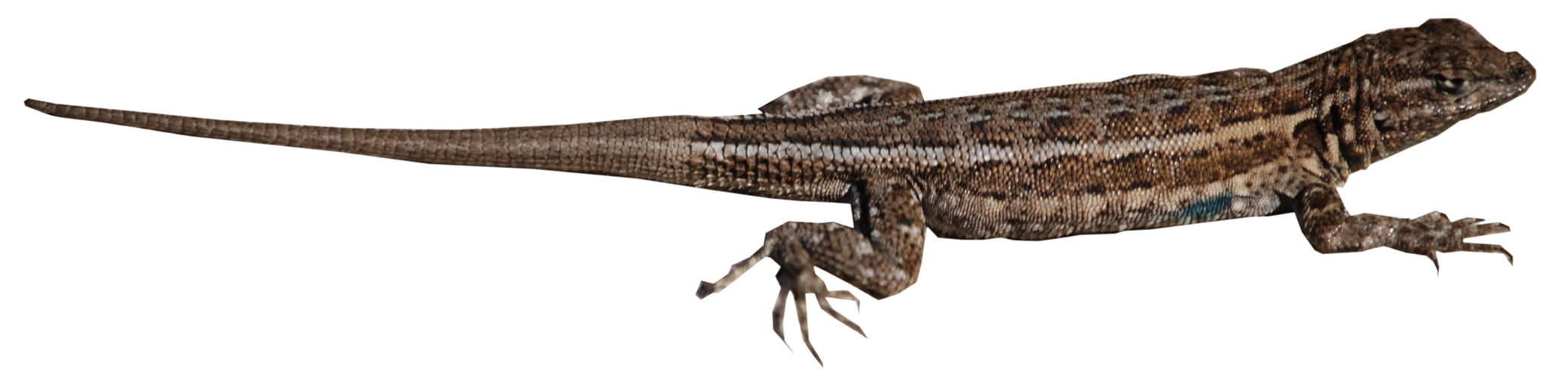
Introduzione al progetto
Presented by: Alessandro Scala and Salvatore Salerno
Presentata da: Salvatore Salerno
Università di Pisa
Dipartimento di Informatica
Computation Models for Complex Systems
Computation Models for Complex Systems
Modelling the lizards
The lizards are independent agents who, based on their sex and morph, behave and interact differently. To model them, we decided to create a common class that shares the common parameters whose values vary depending on the specific lizard:
SEX:
Male || Female
MORPH:
Male: Orange || Yellow || Blue
Female: Orange || Yellow

Slide 11
Introduzione al progetto
Presented by: Alessandro Scala and Salvatore Salerno
Presentata da: Salvatore Salerno
Università di Pisa
Dipartimento di Informatica
Computation Models for Complex Systems
Computation Models for Complex Systems
Modelling the lizards
The lizards are independent agents who, based on their sex and morph, behave and interact differently. To model them, we decided to create a common class that shares the common parameters whose values vary depending on the specific lizard:
SIZE:
baseSize = [20…40]mm
size = baseSize + (male ? 10 : 0) + (orange ? 10 : 0)
AGE:
Baby || Adult

Slide 12
Introduzione al progetto
Presented by: Alessandro Scala and Salvatore Salerno
Presentata da: Salvatore Salerno
Università di Pisa
Dipartimento di Informatica
Computation Models for Complex Systems
Computation Models for Complex Systems
Modelling the lizards
The lizards are independent agents who, based on their sex and morph, behave and interact differently. To model them, we decided to create a common class that shares the common parameters whose values vary depending on the specific lizard:
SPEED:
baseSpeed = [2…3]m/h
speed = baseSpeed + (male ? 1 : 0) + (orange ? 0.4 : 0)
LIFETIME:
baseLife = [1…3] years
lifetime = baseLife + (male? -1 :0) + (orange ? -0.5 : 0)

Slide 13
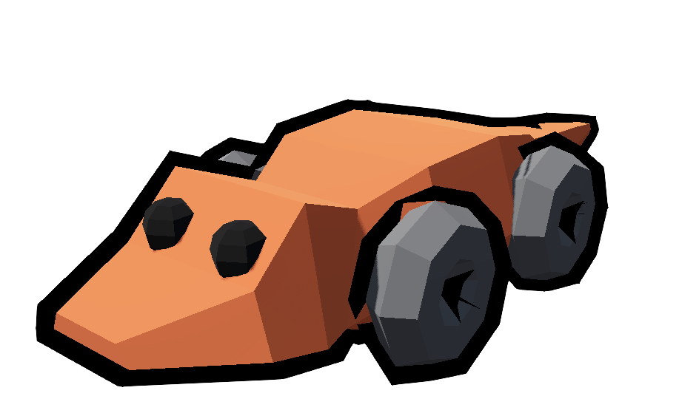
Introduzione al progetto
Presented by: Alessandro Scala and Salvatore Salerno
Presentata da: Salvatore Salerno
Università di Pisa
Dipartimento di Informatica
Computation Models for Complex Systems
Computation Models for Complex Systems
Modelling the Orange Morph
They are the largest in size and most aggressive morph, winning
most of their fights.
Their territory extends up to 100 m² in which they keep a large number of females.
They have a significantly reduced yearly
survival rate compared to the other two morphs.
They are adept at stealing territories from
blue-throated individuals, but are vulnerable
to the yellow morph.

Slide 14
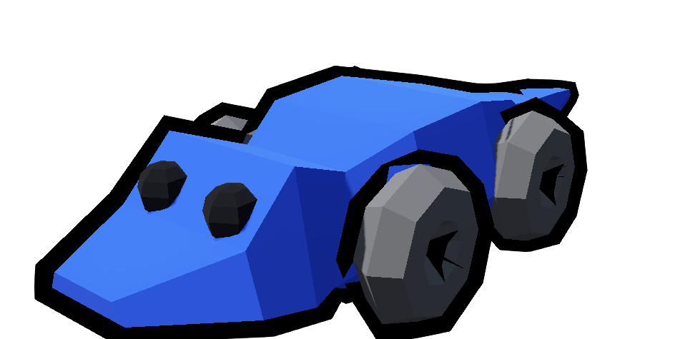
Introduzione al progetto
Presented by: Alessandro Scala and Salvatore Salerno
Presentata da: Salvatore Salerno
Università di Pisa
Dipartimento di Informatica
Computation Models for Complex Systems
Computation Models for Complex Systems
Modelling the Blue Morph
They are of intermediate size and less aggressive than the orange lizards, losing most of the fights against them.
Their territory is small, guarding only one female.
They are better at catching yellow-throated sneakers,but are also susceptible to having their territory stolen by the more aggressive orange-throated males.

Slide 15
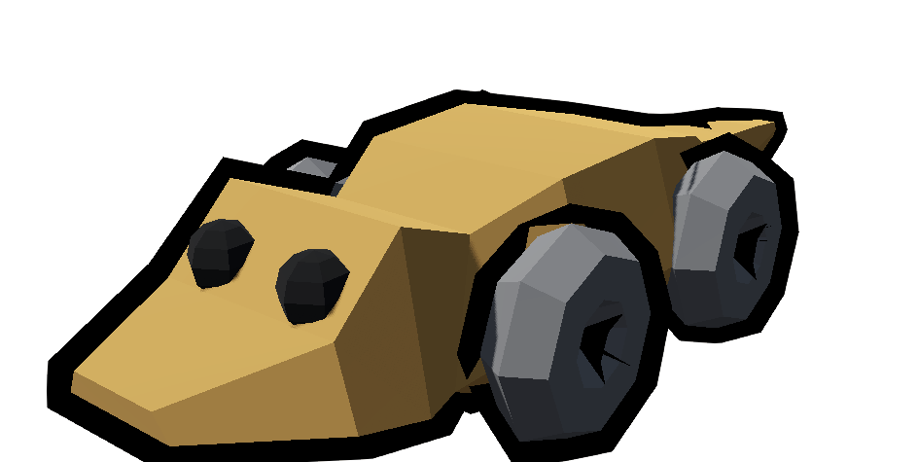
Introduzione al progetto
Presented by: Alessandro Scala and Salvatore Salerno
Presentata da: Salvatore Salerno
Università di Pisa
Dipartimento di Informatica
Computation Models for Complex Systems
Computation Models for Complex Systems
Modelling the Yellow Morph
Their looks and behavior is similar to females, and they typically mimic female "rejection" displays when they encounter dominant orange- or blue-throated males.
Unlike the other morphs, yellow-throated males do not hold territories.

Slide 16
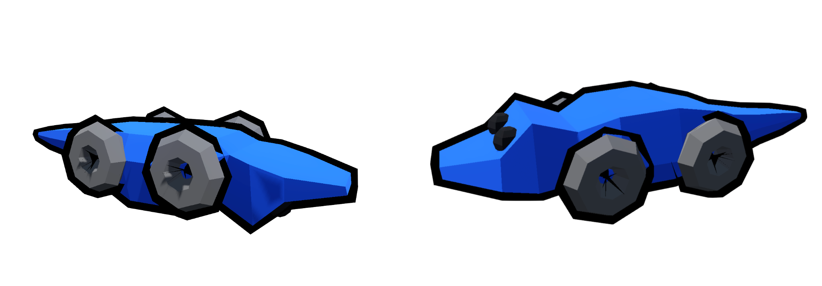
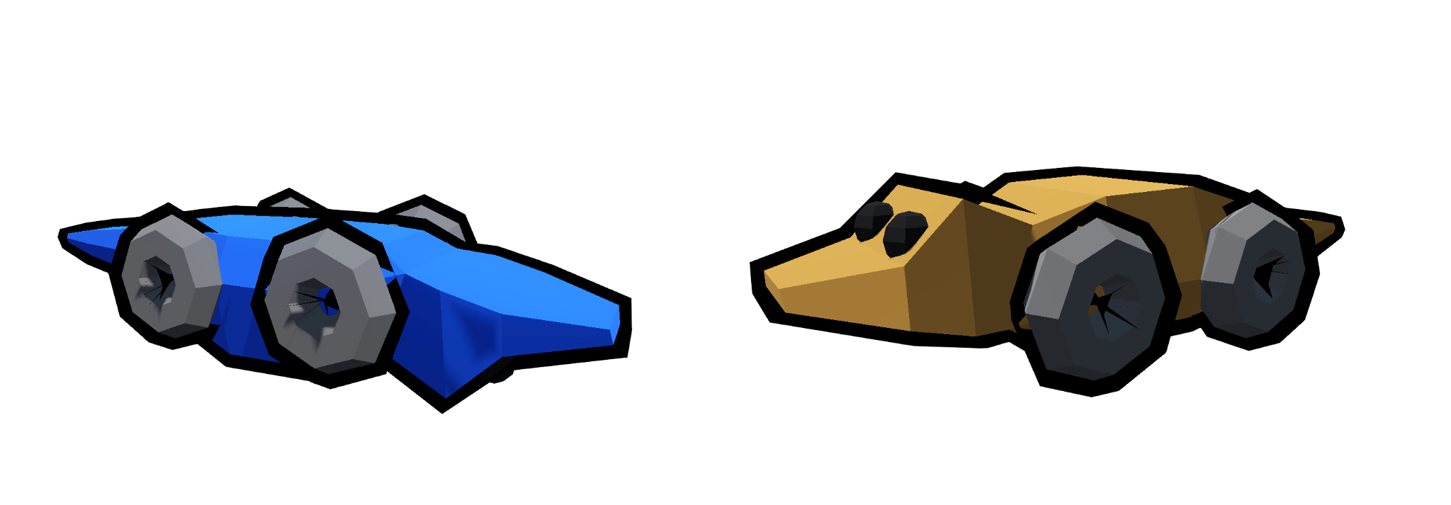
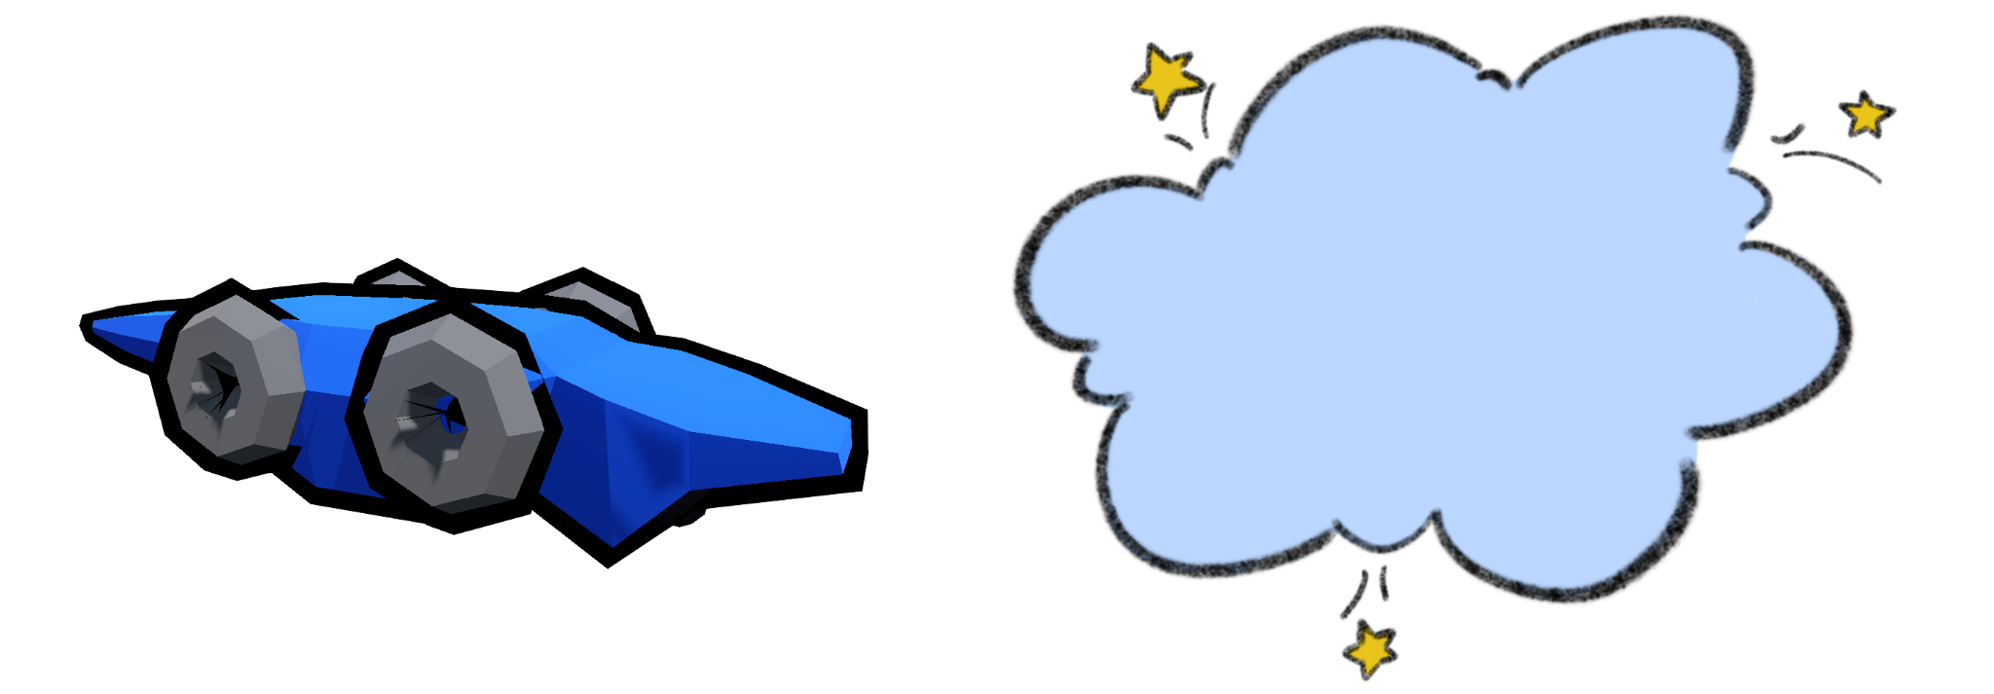
Introduzione al progetto
Presented by: Alessandro Scala and Salvatore Salerno
Presentata da: Salvatore Salerno
Università di Pisa
Dipartimento di Informatica
Computation Models for Complex Systems
Computation Models for Complex Systems
Modelling the Yellow Morph - Bluecoming
If a blue dominant male dies in the proximity of a yellow-throated one, it occurs that the latters changes is morph, giving up its female mimicry and adopting the “dominant” blue morph’s behavior pattern.

Slide 17
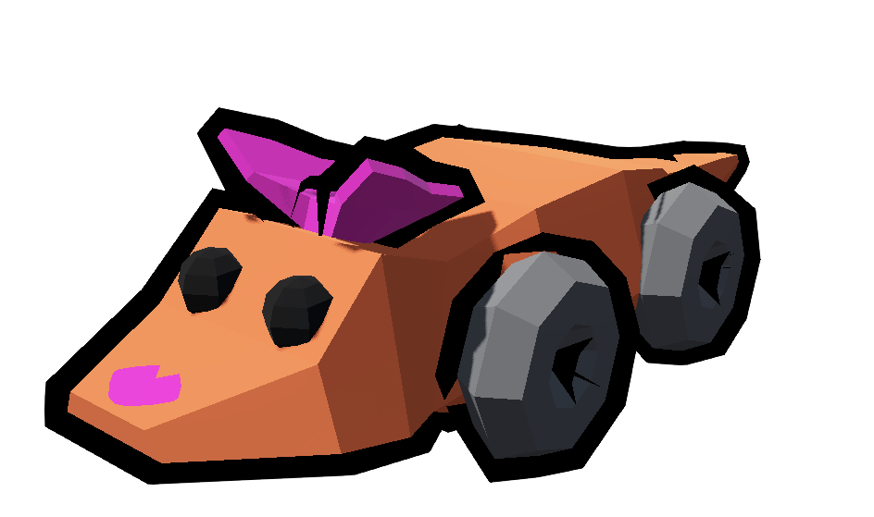
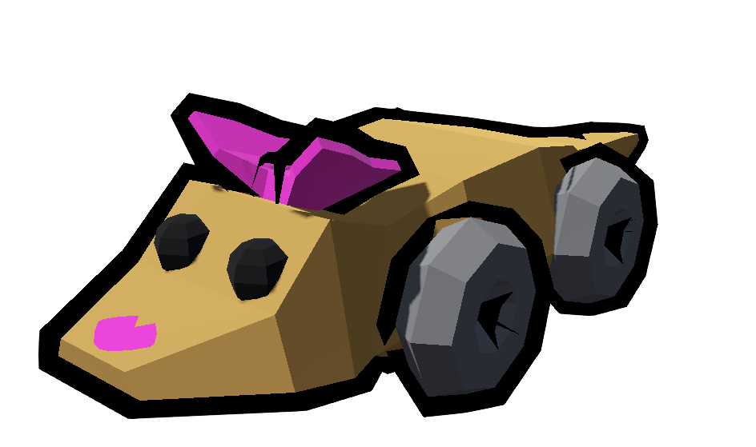
Introduzione al progetto
Presented by: Alessandro Scala and Salvatore Salerno
Presentata da: Salvatore Salerno
Università di Pisa
Dipartimento di Informatica
Computation Models for Complex Systems
Computation Models for Complex Systems
Modelling the Females
Females can either roam around the desert or stay in a male territory.
They pick a territory owned by a male and stay on it until her or the owner dies.
On average their lifespan is higher than the males.
There exist no blue-throated female lizards.

Slide 18
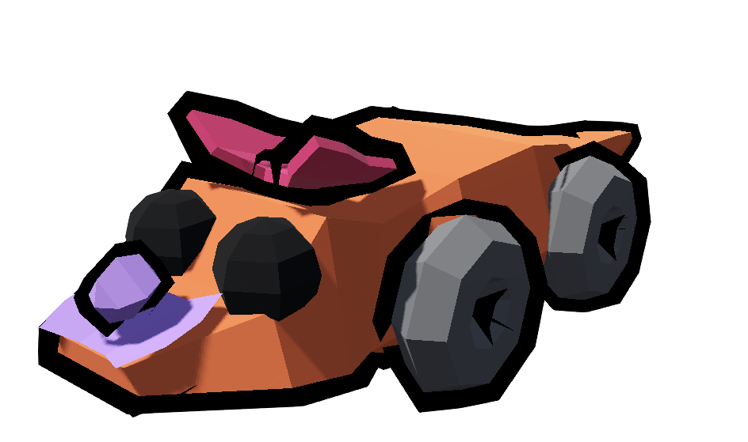
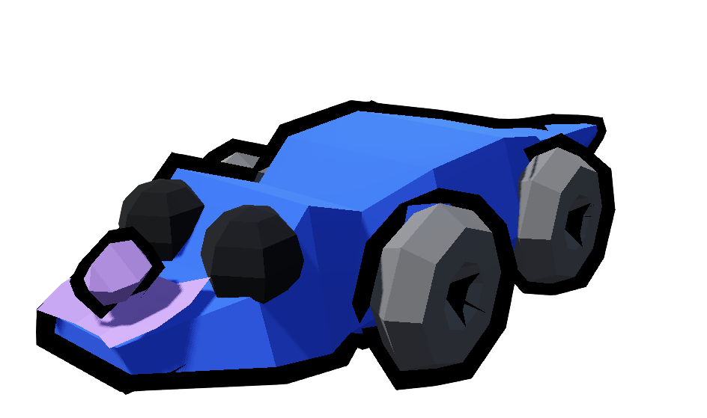
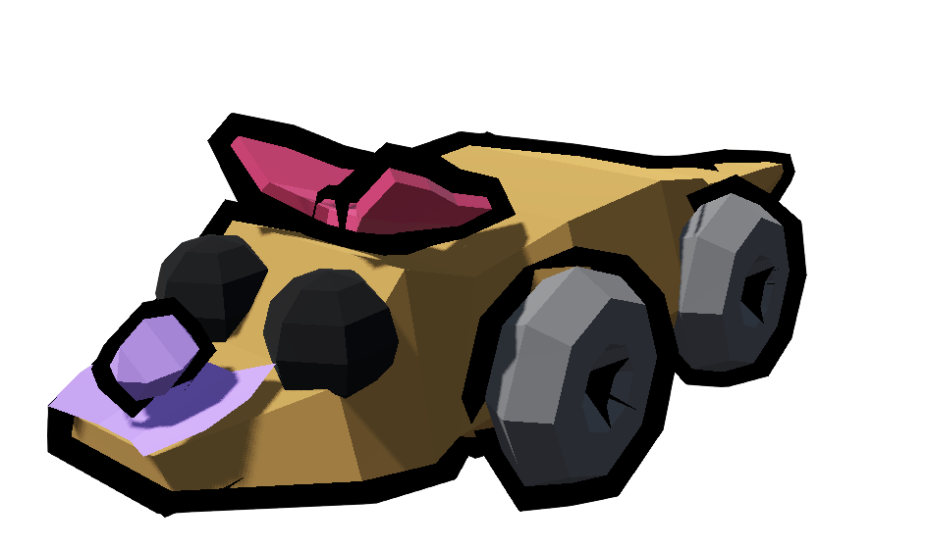
Introduzione al progetto
Presented by: Alessandro Scala and Salvatore Salerno
Presentata da: Salvatore Salerno
Università di Pisa
Dipartimento di Informatica
Computation Models for Complex Systems
Computation Models for Complex Systems
Modelling the Children
Children are ignored by adults regardless of their sex.
Once maturity is reached, they are dismissed from the territory by the male and females.
We assume that children do not die.

Slide 19
Introduzione al progetto
Presented by: Alessandro Scala and Salvatore Salerno
Presentata da: Salvatore Salerno
Università di Pisa
Dipartimento di Informatica
Computation Models for Complex Systems
Computation Models for Complex Systems
Alleles combinations
OY || OB || OO || BO || YO
BB
YB || YY || BY

Slide 20
Nozioni sulle immagini digitali
Presented by: Alessandro Scala and Salvatore Salerno
Presentata da: Salvatore Salerno
Università di Pisa
Dipartimento di Informatica
Computation Models for Complex Systems
Computation Models for Complex Systems
Outline
Introduction to the lizard species
Rock-Paper-Scissors Pattern
Using the Godot Engine
Modelling the morphs
Modelling behaviours
Conclusions

Slide 21
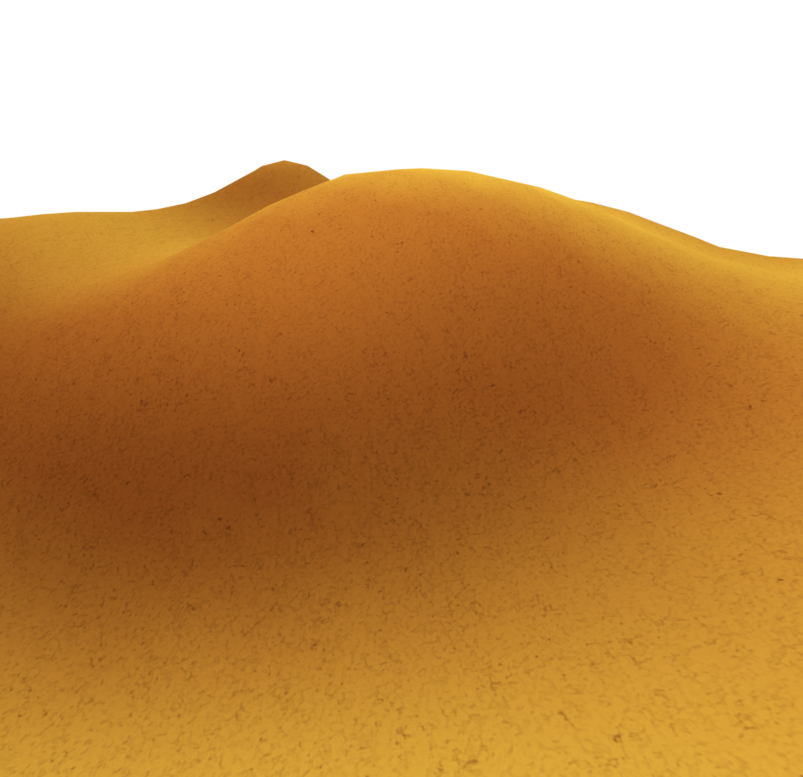

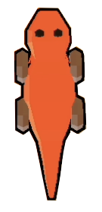

Nozioni sulle immagini digitali
Presented by: Alessandro Scala and Salvatore Salerno
Presentata da: Salvatore Salerno
Università di Pisa
Dipartimento di Informatica
Computation Models for Complex Systems
Computation Models for Complex Systems
Modelling behaviours: deciding territory
A male will search the highest point in the area around him, reaching it and repeating the process.
It will stop if it does not find a better point compared to where it stands or if it is tired of searching.
What they find is not always the most strategic point in the whole desert, but the local maximum.

Slide 22
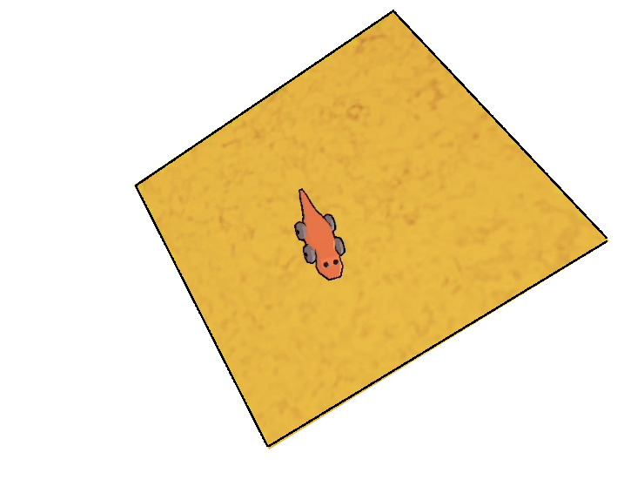
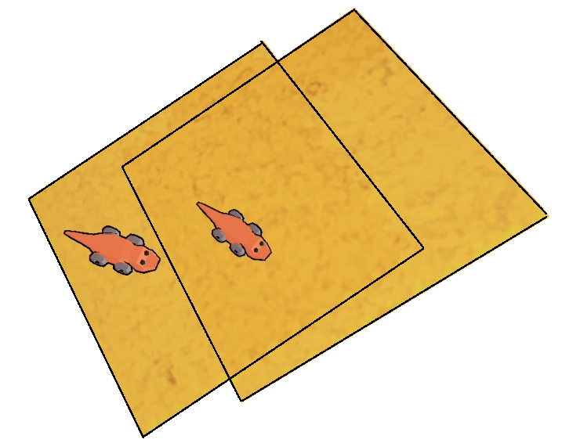
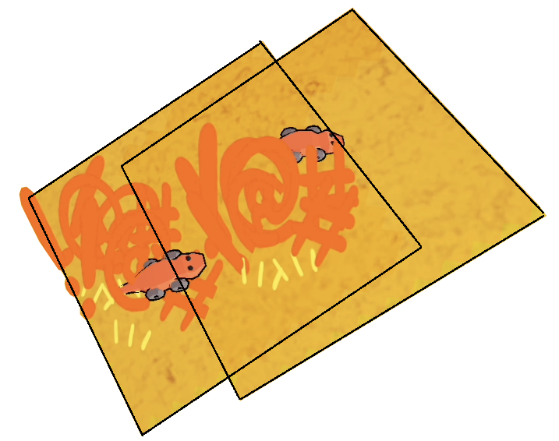
Nozioni sulle immagini digitali
Presented by: Alessandro Scala and Salvatore Salerno
Presentata da: Salvatore Salerno
Università di Pisa
Dipartimento di Informatica
Computation Models for Complex Systems
Computation Models for Complex Systems
Modelling behaviours: managing a territory
When a male has a territory, it roams around it.
When another male happens to create a territory overlapping another one, eventually a fight will ensue.
The one who wins will keep its territory, while the other will die and lose its.

Slide 23
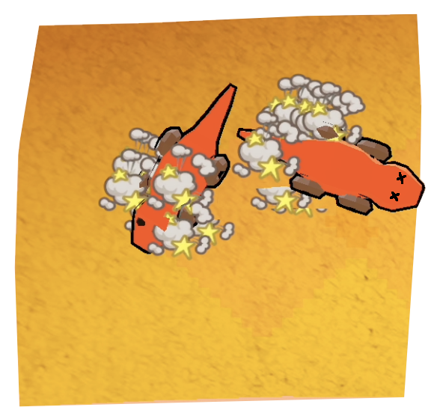
Nozioni sulle immagini digitali
Presented by: Alessandro Scala and Salvatore Salerno
Presentata da: Salvatore Salerno
Università di Pisa
Dipartimento di Informatica
Computation Models for Complex Systems
Computation Models for Complex Systems
Modelling behaviours: fighting ground
Males will enter a fight when trying to steal the territory of each other or when a sneaker is found by the owner of the territory.
The winner is decided by the size and morph of the lizard.
Orange males are the most likely to win.
The winner will return to its territory (if it has one), the loser will die.

Slide 24
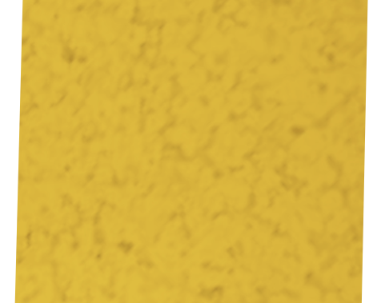
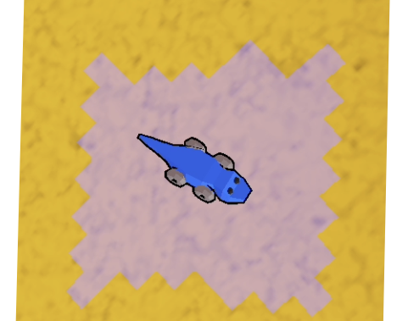
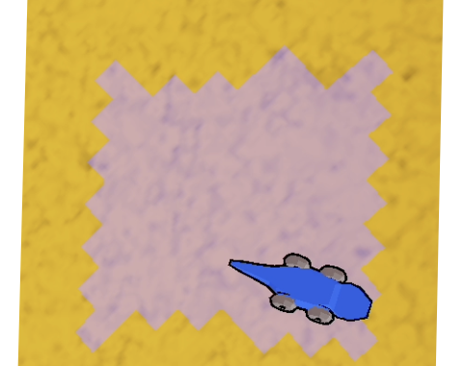
Nozioni sulle immagini digitali
Presented by: Alessandro Scala and Salvatore Salerno
Presentata da: Salvatore Salerno
Università di Pisa
Dipartimento di Informatica
Computation Models for Complex Systems
Computation Models for Complex Systems
Modelling behaviours: dying
When a male dies, the territory is erased, unless a yellow lizard takes the place of the owner (aka bluecoming).
When a territory is erased, all females in that territory will search for a new one.

Slide 25
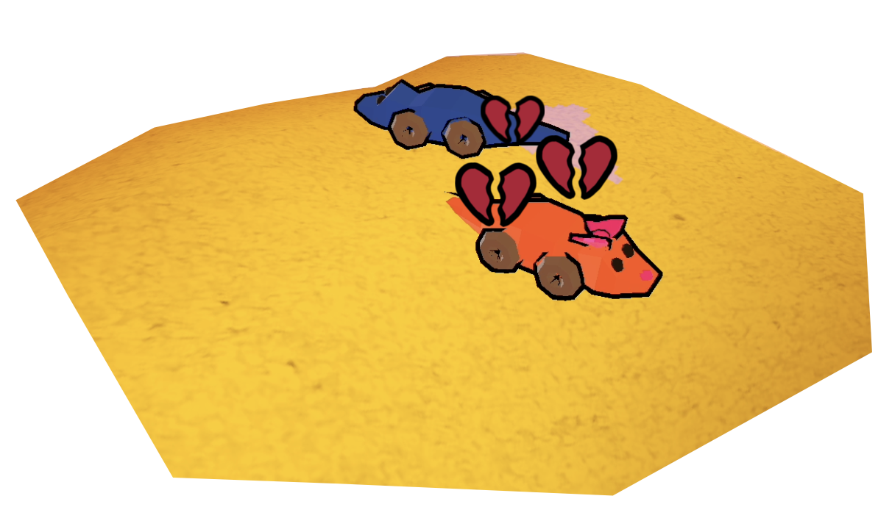
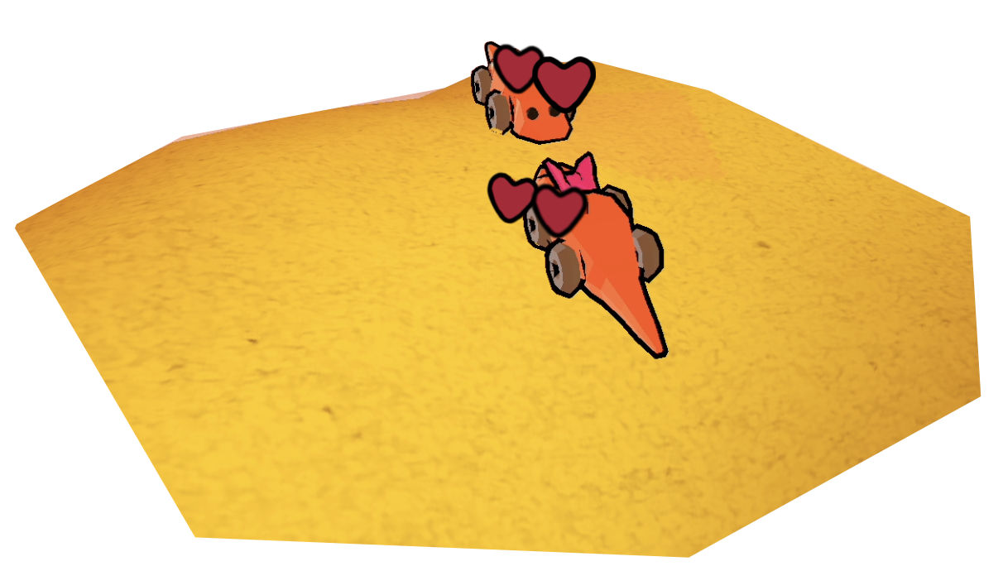
Nozioni sulle immagini digitali
Presented by: Alessandro Scala and Salvatore Salerno
Presentata da: Salvatore Salerno
Università di Pisa
Dipartimento di Informatica
Computation Models for Complex Systems
Computation Models for Complex Systems
Modelling behaviours: the mysteries of love
Females can meet males by entering a territory or, when already in one, by encountering the owner or a yellow male.
They will decide to mate depending on the morph and size of the male.
If the mating goes through, a child will be born shortly after. Otherwise, the female rejects the male, breaking its heart in the process.

Slide 26
Nozioni sulle immagini digitali
Presented by: Alessandro Scala and Salvatore Salerno
Presentata da: Salvatore Salerno
Università di Pisa
Dipartimento di Informatica
Computation Models for Complex Systems
Outline
Introduction to the lizard species
Rock-Paper-Scissors Pattern
Using the Godot Engine
Modelling the morphs
Modelling behaviours
Conclusions

Slide 27
Conclusioni
Presented by: Alessandro Scala and Salvatore Salerno
Presentata da: Salvatore Salerno
Università di Pisa
Dipartimento di Informatica
Computation Models for Complex Systems
Computation Models for Complex Systems
Conclusions
We have modeled the rock-paper-scissors mating behavior of the peculiar “Uta stansburiana” lizard species.
To implement our model we have used the Godot Engine which allowed us to model our population in a 3D environment.
By observing simulations of our model we have seen the typical rock-paper-scissors population oscillating behavior between the various morphs.

Slide 28
Conclusioni
Presented by: Alessandro Scala and Salvatore Salerno
Presentata da: Salvatore Salerno
Università di Pisa
Dipartimento di Informatica
Computation Models for Complex Systems
Computation Models for Complex Systems
Thank you for your attention!

Slide 29
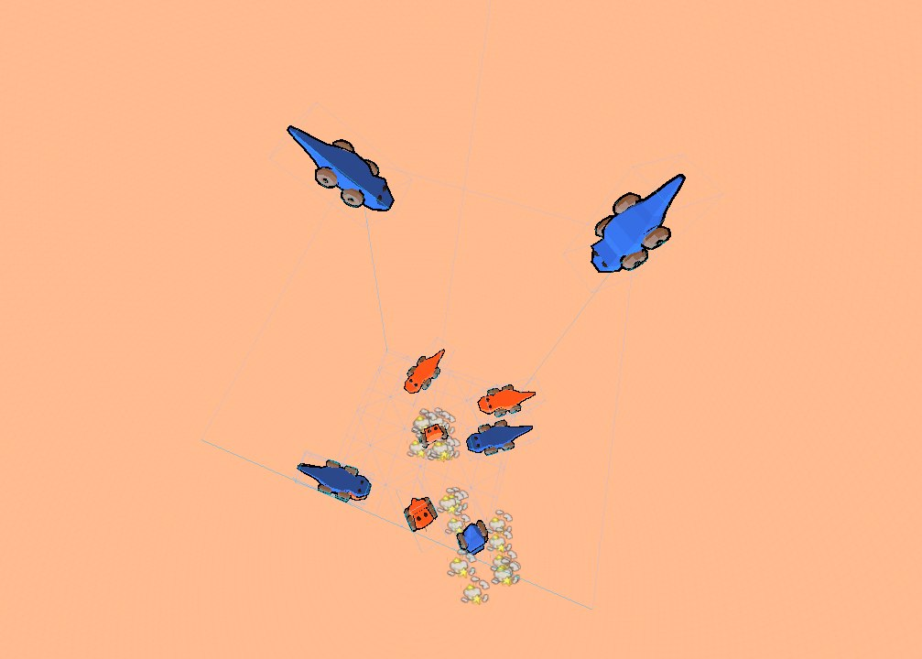
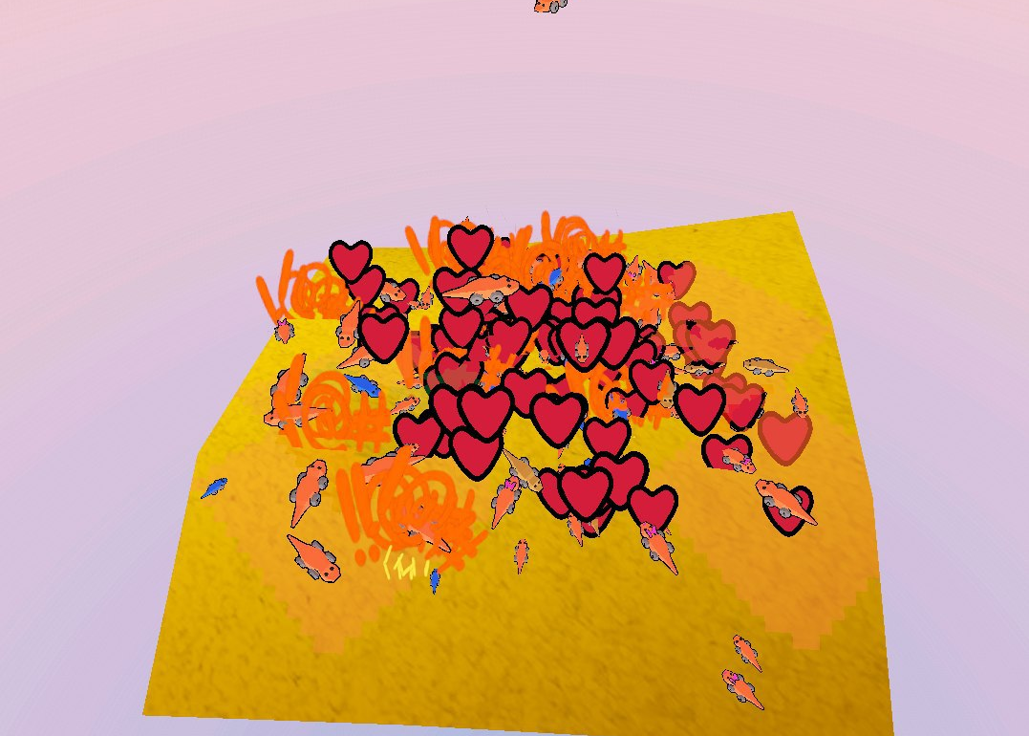
Conclusioni
Presented by: Alessandro Scala and Salvatore Salerno
Presentata da: Salvatore Salerno
Università di Pisa
Dipartimento di Informatica
Computation Models for Complex Systems
Computation Models for Complex Systems
Bloopers
Fighting beyond boundaries
Love and War

Slide 30
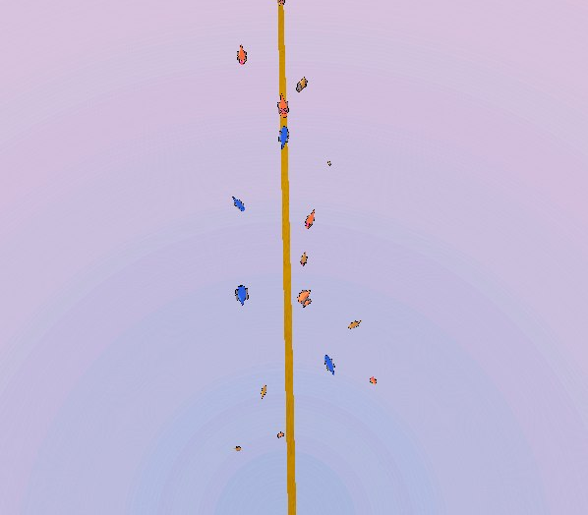
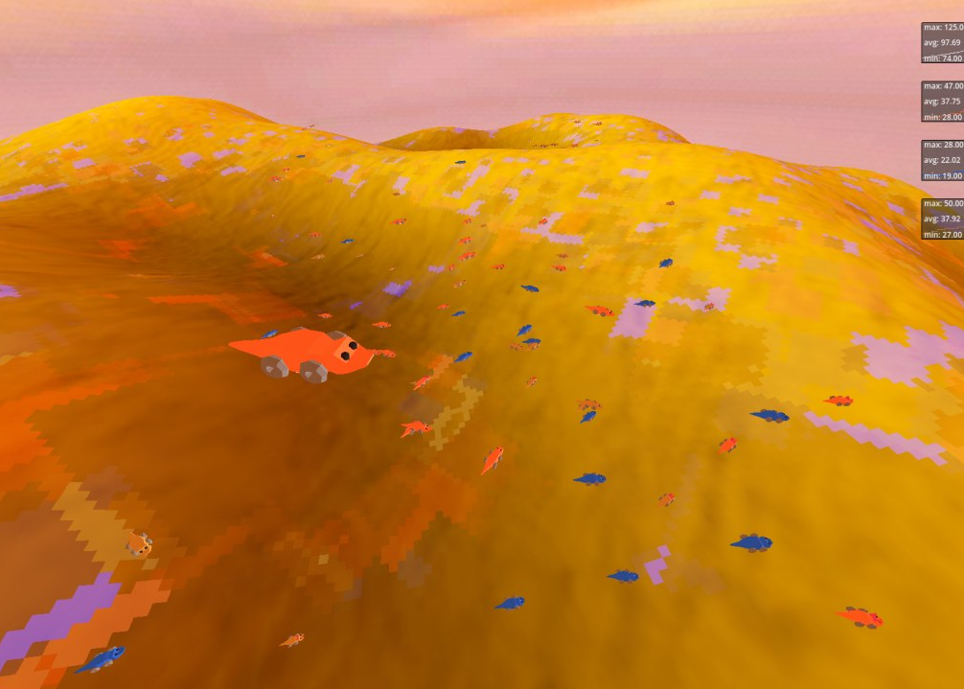
Conclusioni
Presented by: Alessandro Scala and Salvatore Salerno
Presentata da: Salvatore Salerno
Università di Pisa
Dipartimento di Informatica
Computation Models for Complex Systems
Computation Models for Complex Systems
Bloopers
1D Desert
Attack of the giant lizard

Slide 31
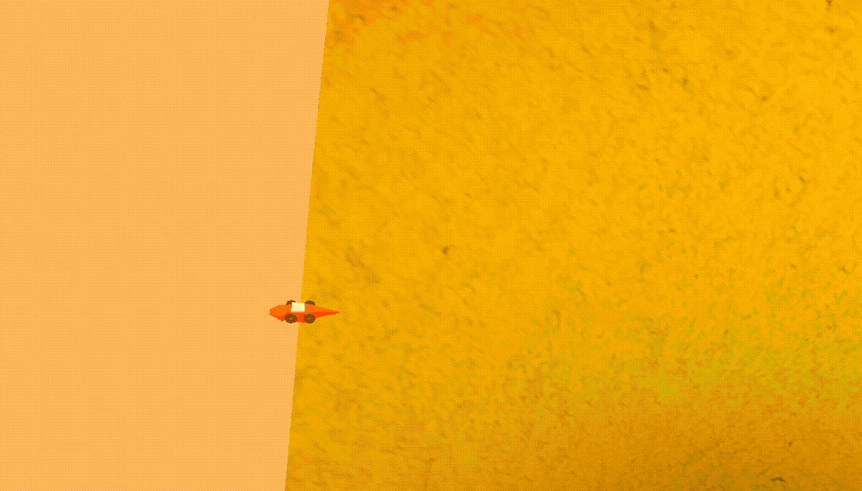
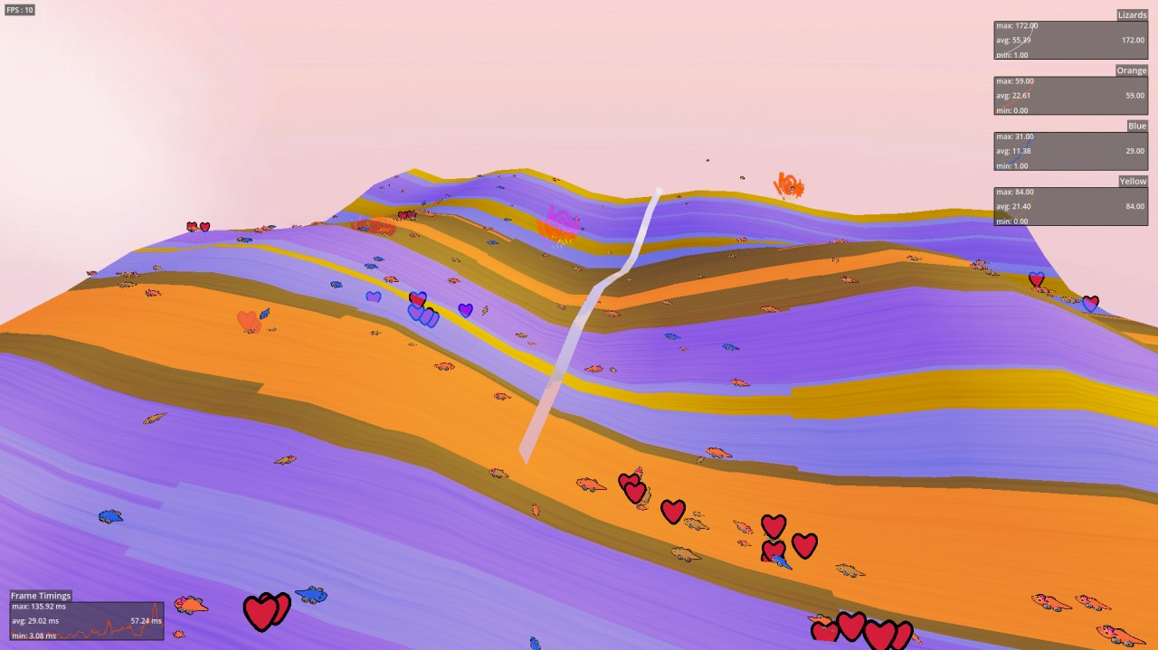
Conclusioni
Presented by: Alessandro Scala and Salvatore Salerno
Presentata da: Salvatore Salerno
Università di Pisa
Dipartimento di Informatica
Computation Models for Complex Systems
Computation Models for Complex Systems
Bloopers
You spin me round
Carnival in May

